Slide 1

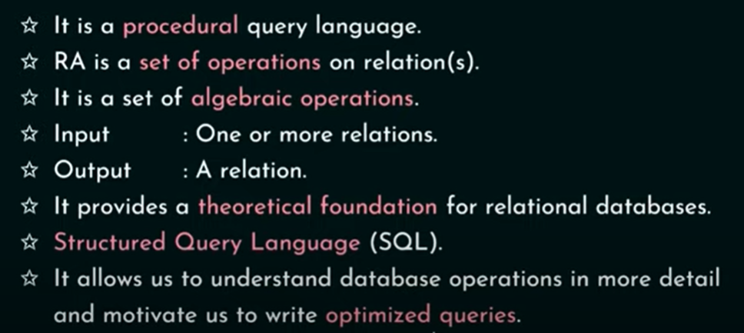
https://www.youtube.com/watch?v=76v3gRns28U

Slide 2

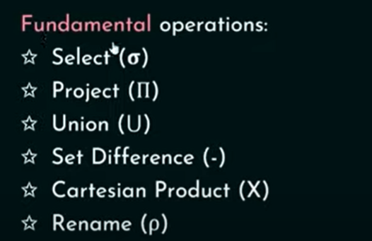

Slide 3
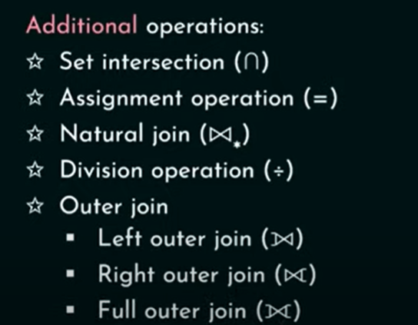

Slide 4
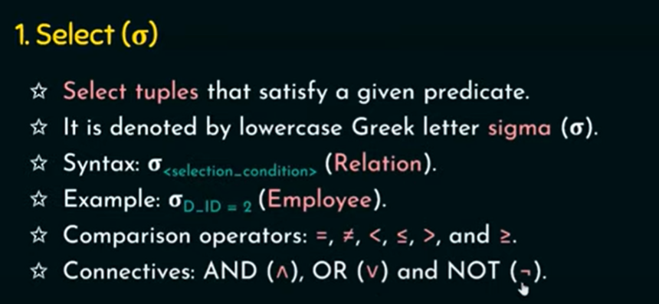
https://www.youtube.com/watch?v=Givp56x6vbg

Slide 5
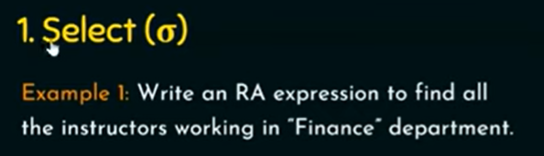
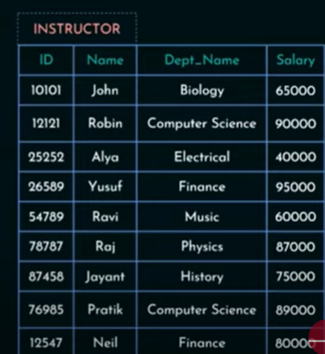

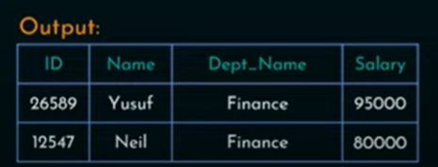

Slide 6


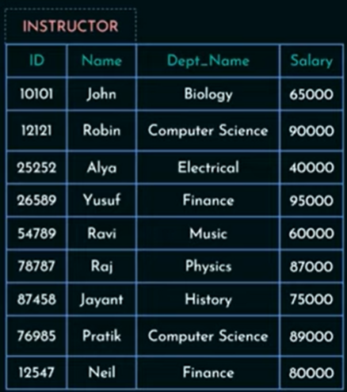

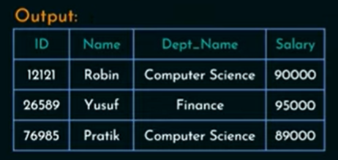

Slide 7
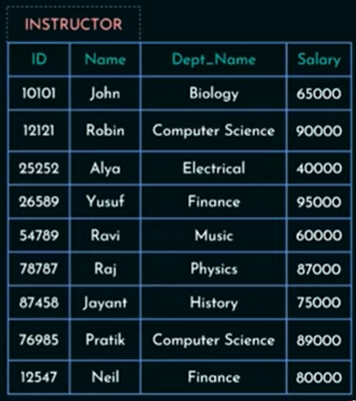
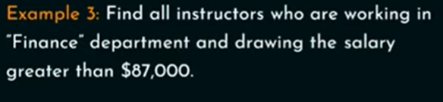

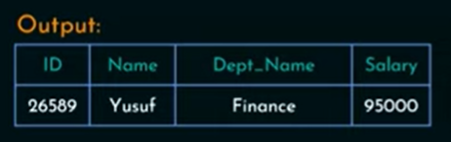

Slide 8
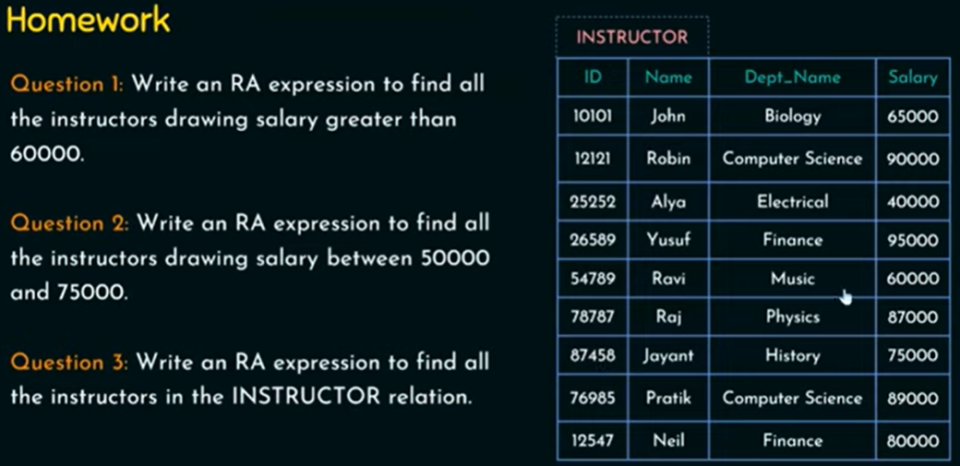

Slide 9
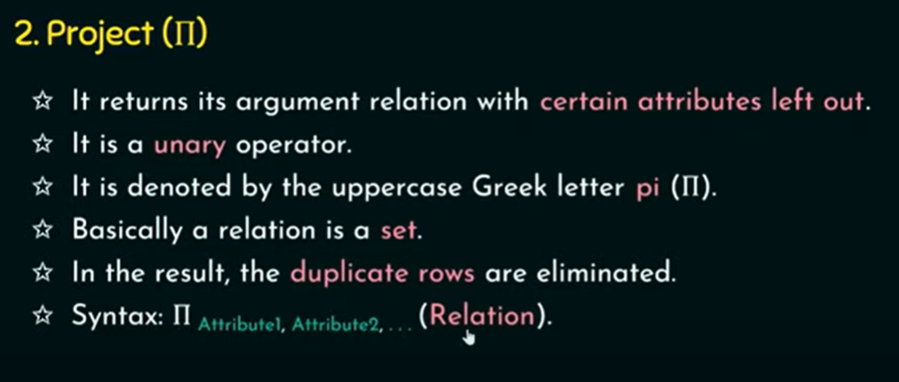
https://www.youtube.com/watch?v=QY2X_TlLkqo

Slide 10
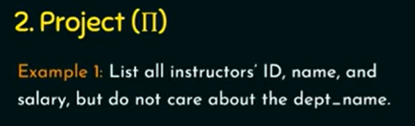
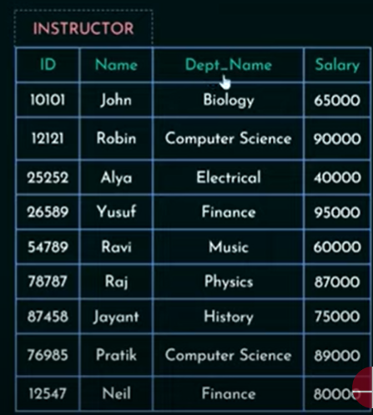




Slide 11

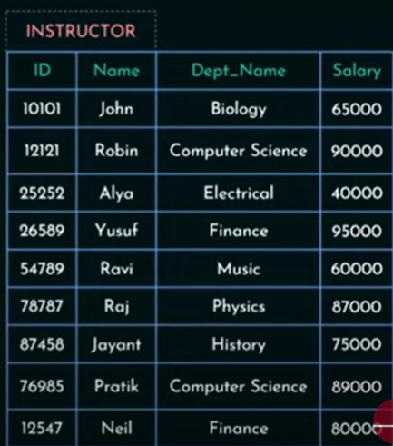



Slide 12
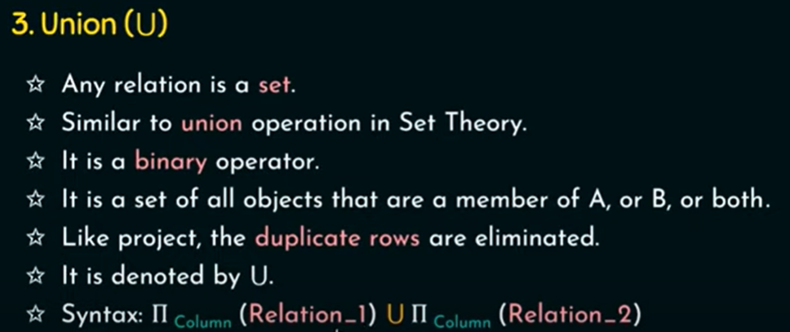
https://www.youtube.com/watch?v=bx-O6kWgIs8

Slide 13
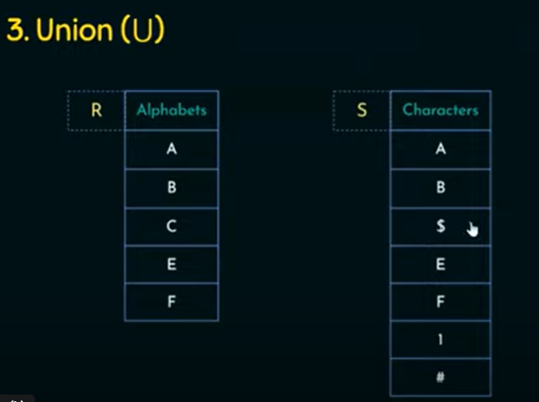


Slide 14
Union operator is denoted by ∪ symbol and it is used to select all the rows (tuples) from two tables (relations).
Lets say we have two relations R1 and R2 both have same columns and we want to select all the tuples(rows) from these relations then we can apply the union operator on these relations.
Note: The rows (tuples) that are present in both the tables will only appear once in the union set. In short you can say that there are no duplicates present after the union operation.

Slide 15

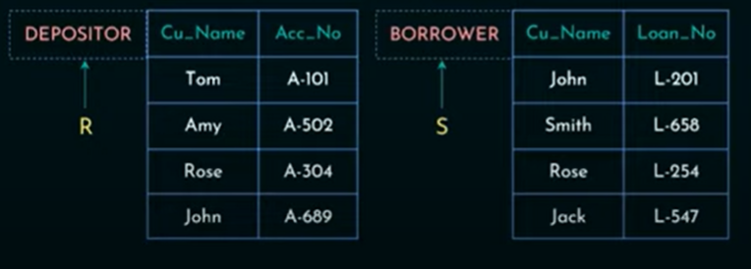
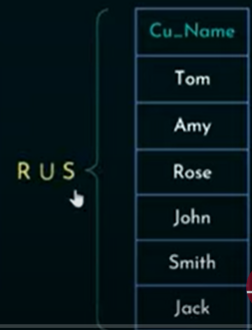

Slide 16
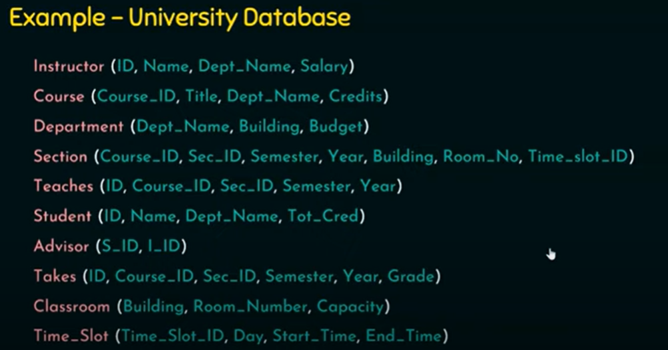

Slide 17





Slide 18
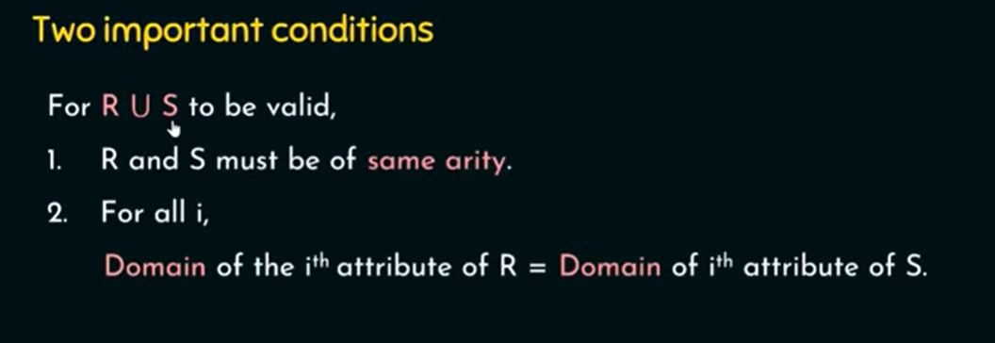

Slide 19
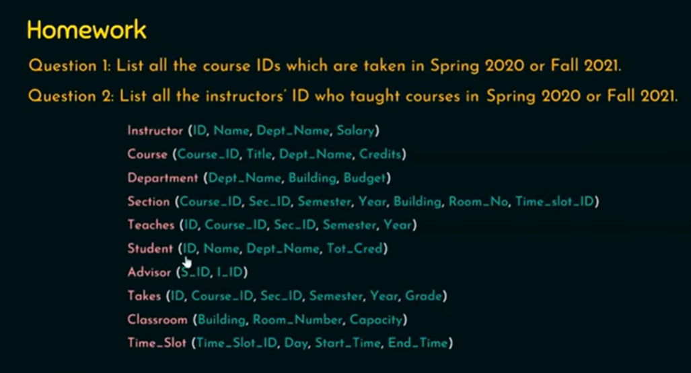

Slide 20
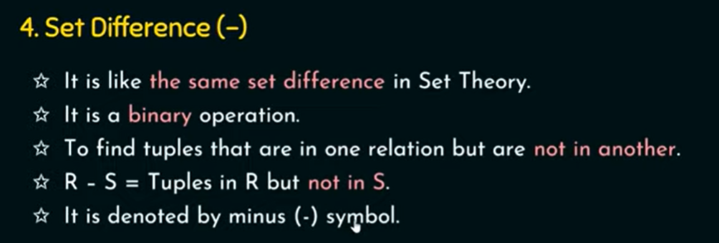
https://www.youtube.com/watch?v=dS214kONAZA

Slide 21
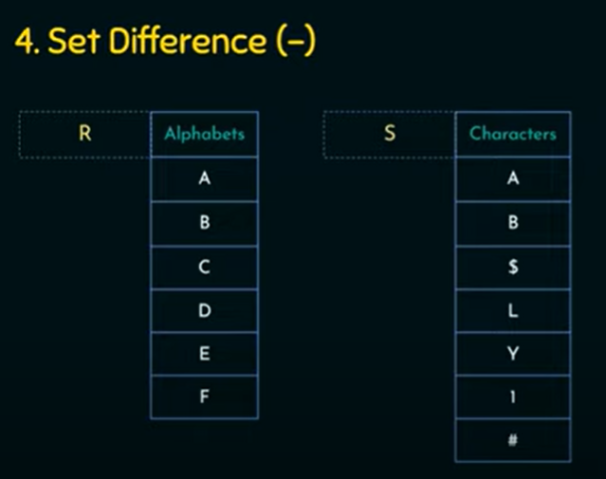


Slide 22
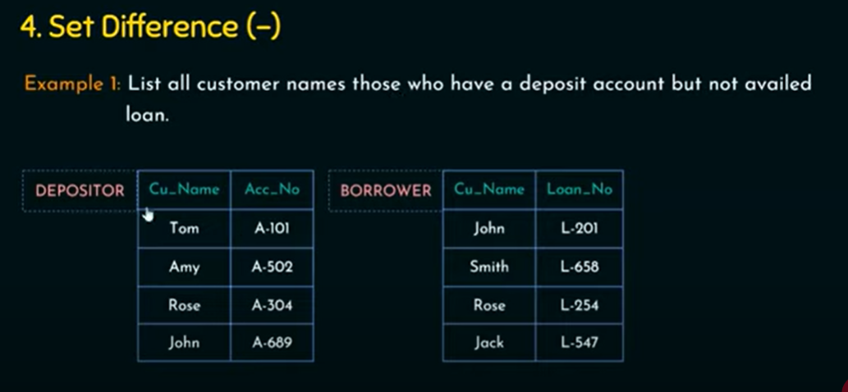
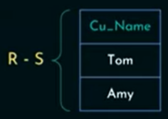

Slide 23
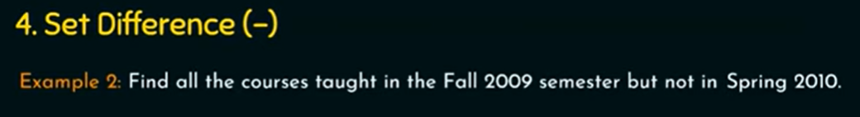


Slide 24
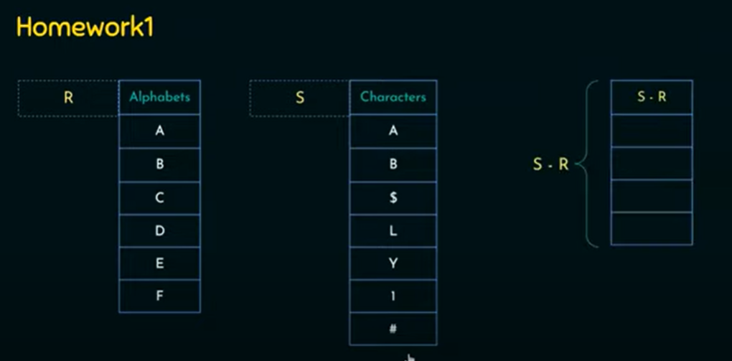

Slide 25
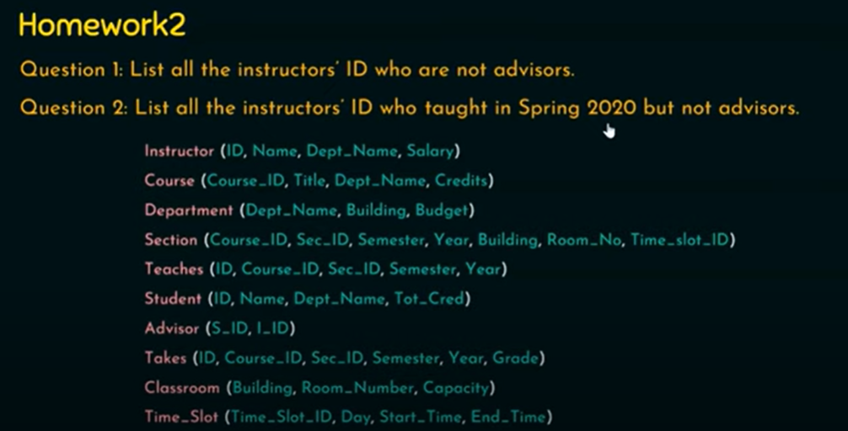

Slide 26

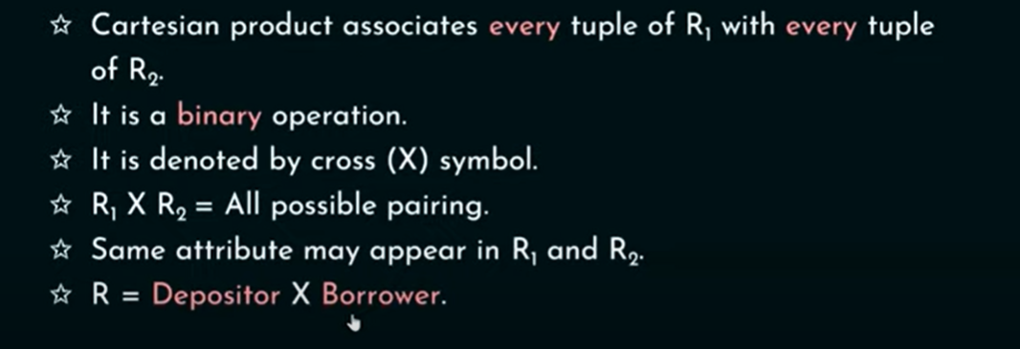

Slide 27

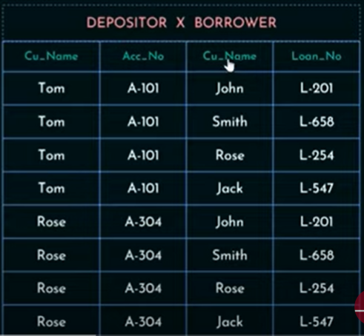
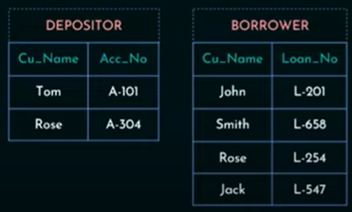
https://www.youtube.com/watch?v=qvioqCvvMek

Slide 28
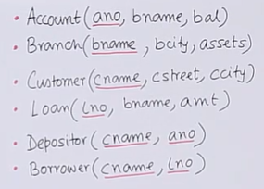
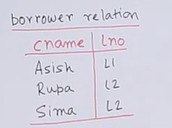
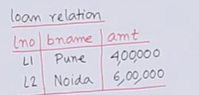
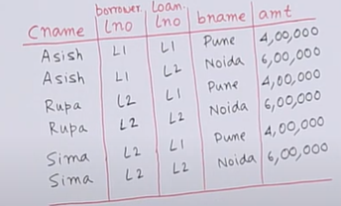


Example No.02
https://www.youtube.com/watch?v=cNpZQCOBjoY

Slide 29
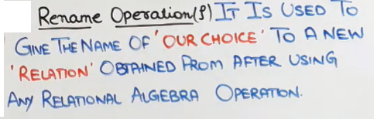
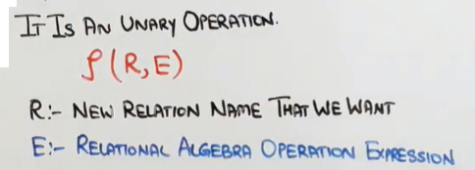

https://www.youtube.com/watch?v=waxA8Bgok2c

Slide 30
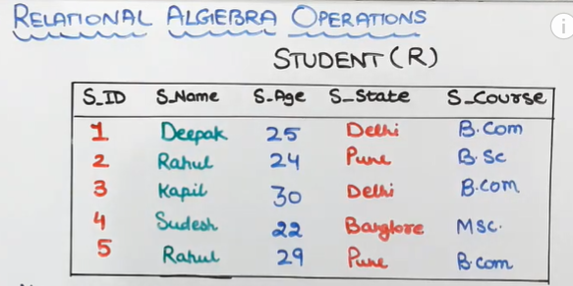

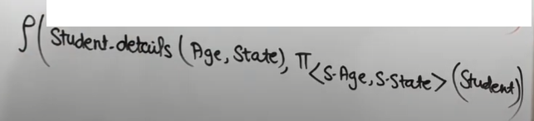

Rename variables S-Age and S-State to Age and State respectively
Retrieve age and state from student relation and store result in Student-detail

Slide 31
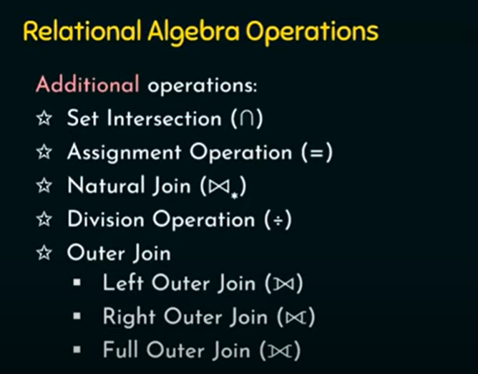

Slide 32

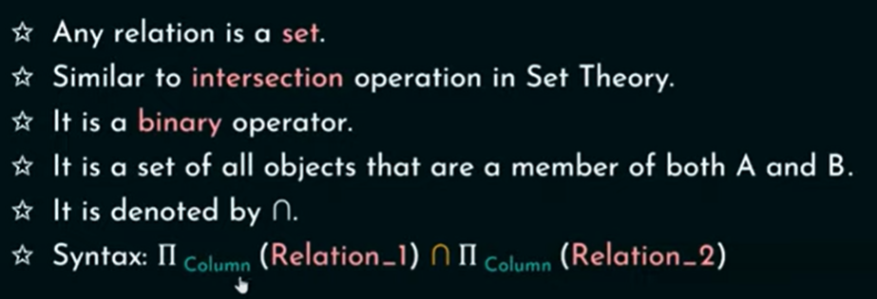
https://www.youtube.com/watch?v=NwgNWtkqDYM

Slide 33
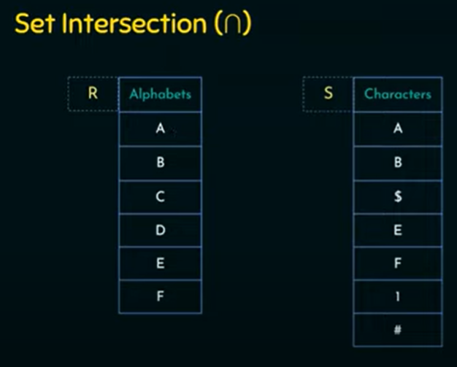


Slide 34

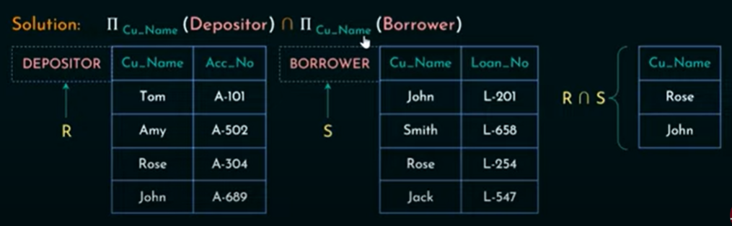

Slide 35
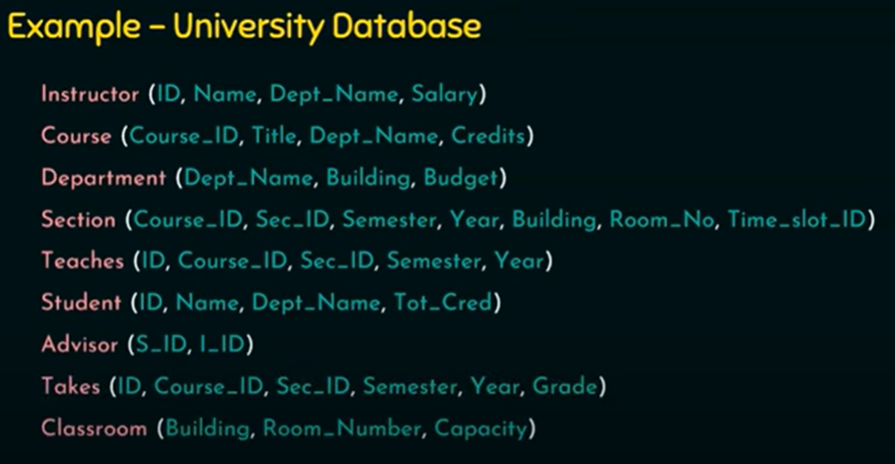

Slide 36
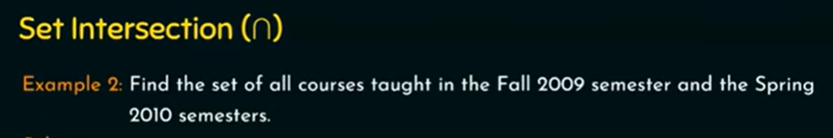



Slide 37

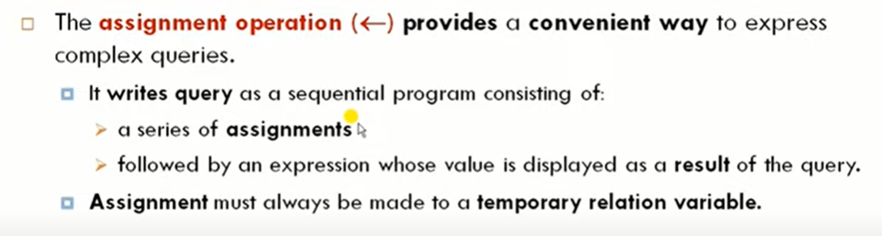
https://www.youtube.com/watch?v=FG0ndNastu4

Slide 38






Slide 39
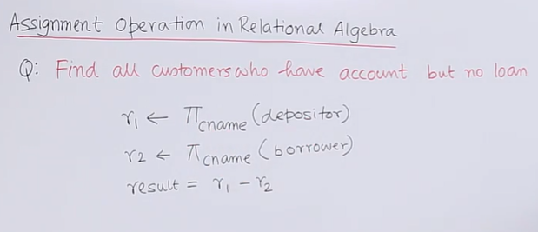

Assignment Operator – Example No.02
https://www.youtube.com/watch?v=MyQnpZnRzmE

Slide 40



https://www.youtube.com/watch?v=28V421ajsQI

Slide 41



Slide 42




Slide 43


https://www.youtube.com/watch?v=zVZzJHSQlSw

Slide 44



Slide 45






Slide 46


Join = Cross Product + Condition
Select E-name from emp where address = “Delhi”
Select E-name from Emp,Dept
where Emp.E-No = Dept.E-No
https://www.youtube.com/watch?v=jRxEjmjIIFs

Slide 47


⋈
Select E-Name from Emp,Dept
where Emp.E-No = Dept.E-No
AND Emp.Adress = Dept.Address
https://www.youtube.com/watch?v=lUiPjkOQG9w

Slide 48


Slide 49




Slide 50

https://www.tutorialspoint.com/dbms/database_joins.htm

Slide 51


Slide 52
⋈
Select E-Name from Emp,Dept
where Emp.E-No = Dept.E-No
AND Emp.Adress = Dept.Address
(Emp
⋈
Dept)
∏ E-Name (σ Emp.E-No = Dept.E-No ∧ Emp.Adress = Dept.Address)
https://www.guru99.com/joins-sql-left-right.html

